Slide 1
GREEDY METHOD
UNIT 2

Slide 2
THE GENERAL METHOD
Most straightforward design technique
Feasible solution: Any subset that satisfies the problem constraint
Optimal solution: A feasible solution that maximizes or minimizes a given objective function.
Subset paradigm: Locally optimal leads to globally optimal solution.
Ordering paradigm: Make decisions by considering the inputs in some order using optimization criterion
Notes:
A feasible solution satisfies all the problem's constraints. An optimal solution is a feasible solution that results in the largest possible objective function value when maximizing (or smallest when minimizing).

Slide 3
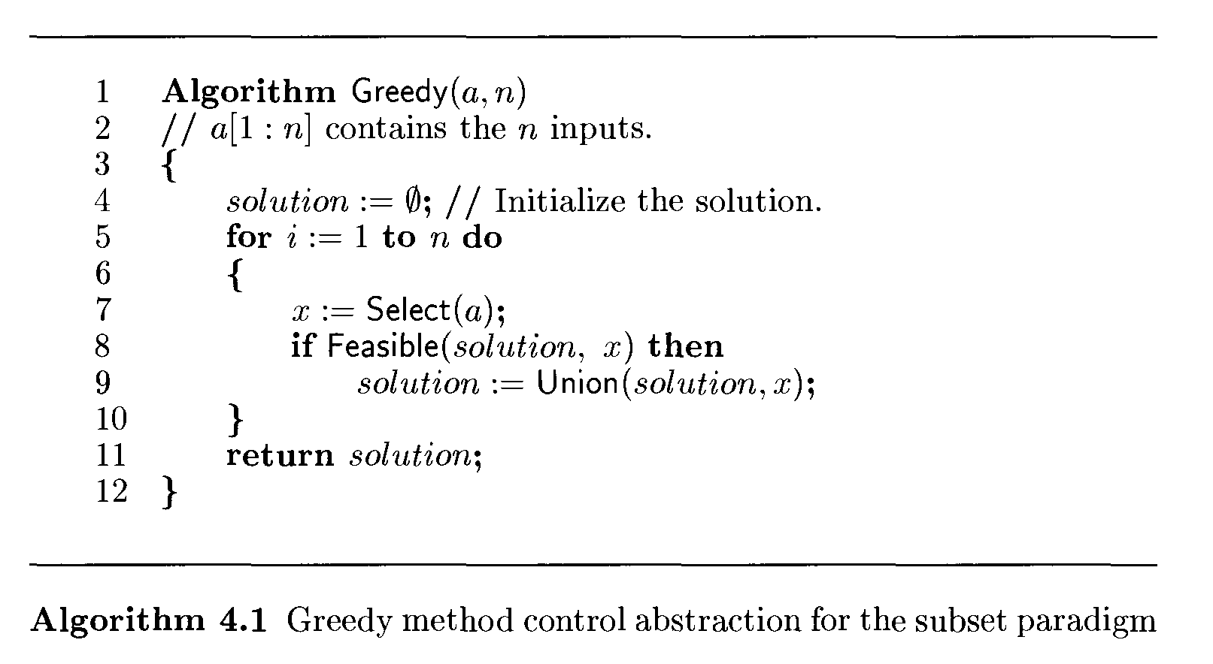
Greedy method control abstraction for subset paradigm
Notes:
The function Select selects an input from A whose value is assign to x
F easible is a Booleanvalued function that determines if x can be included into the solution vector.
The function Union combines x with the solution, and update the objective function.

Slide 4
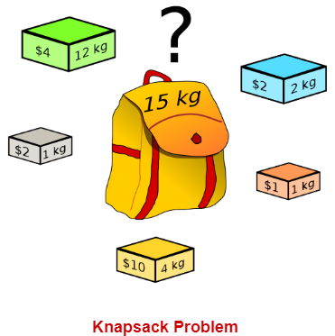
The Knapsack Problem
The classic Knapsack problem is:
A thief breaks into a store and wants to fill his knapsack of capacity K with goods of as much value as possible.
Does there exist a collection of items that fits into his knapsack and whose total value is >= W?

Slide 5
Knapsack Problem
Fractional Knapsack
0/1 Knapsack

Slide 6
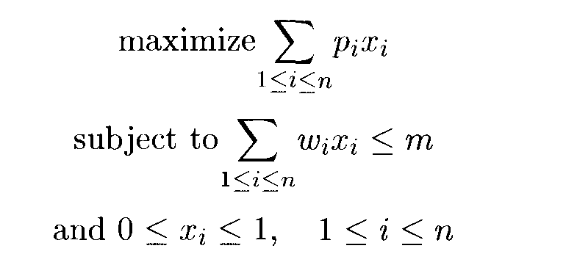
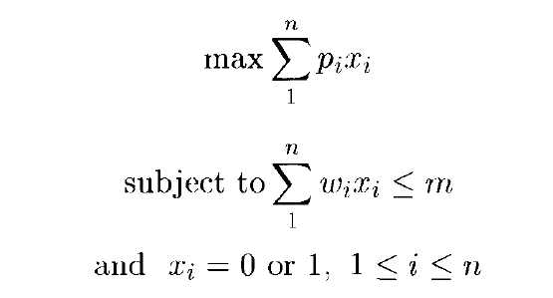
KNAPSACK PROBLEM
Fractional Knapsack
0/1 Knapsack

Slide 7
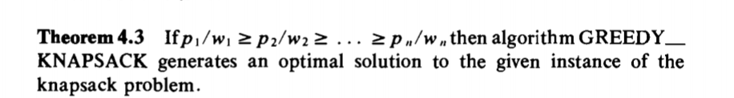

Slide 8
Greedy Methods for Knapsack Problem
First, we can try to fill the knapsack by including next the object with largest profit.
Consider the objects in order of nondecreasing weights W’s
Objects are considered in order of the ratio Pi/wi

Slide 9
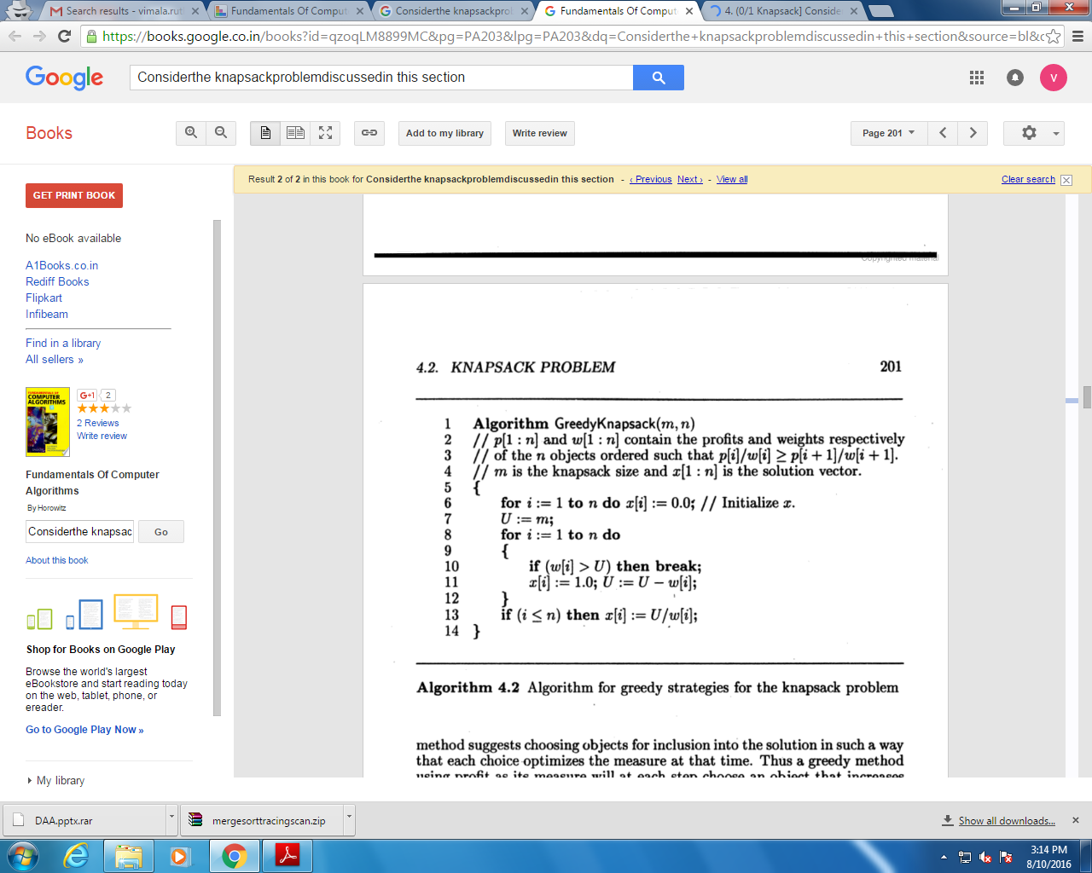
Time Complexity is O(nlogn)
Notes:
Analysis
Fractional Knapsack has time complexity O(NlogN) where N is the number of items in S.
The book suggests assuming S is a heap-based priority queue and then the removal has complexity Θ(logN) so the up to N removals take O(NlogN). The rest of the algorithm is O(N).
Alternatively, S could be a sequence and we could begin Fractional Knapsack by sorting S with a Θ(NlogN) sort. Now the removal is simply removing the first element. If we use a circular list for S, the removal is O(1) so the algorithm is O(N). Including the sort we again have O(NlogN).

Slide 10
Applications
Finding the least wasteful way to cut raw materials.
Selection of investments and portfolios.
Selection of assets for asset-backed securitization
Generating keys for the Merkle–Hellman and other knapsack cryptosystems.
One early application of knapsack algorithms was in the construction and scoring of tests in which the test-takers have a choice as to which questions they answer and score the maximum.

Slide 11
Does Greedy Method give optimal solution for 0-1 Knapsack?
M=60
Items : Pi={100,280,120},Wi={10,40,20}
Greedy approach may not give an optimal solution.
To solve 0-1 Knapsack, Dynamic Programming approach is required.

Slide 15
Examples
Find the optimal solution for the fractional knapsack problem making use of greedy approach.
Problem 1:
n = 5
m = 60 kg
(w1, w2, w3, w4, w5) = (5, 10, 15, 22, 25)
(b1, b2, b3, b4, b5) = (30, 40, 45, 77, 90)
Problem 2:
n=7
m=15
(p1, p2, …, p7) = (10, 5, 15, 7, 6, 18, 3)
(w1, w2, …, w7) = (2, 3, 5, 7, 1, 4, 1)

